Slide 1
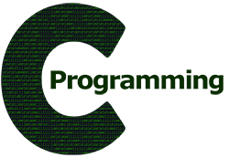
CSE101 Computer Programming
Lecture #0

Slide 2
Course Details
Text Book
“PROGRAMMING IN C”
by
ASHOK N. KAMTHANE
PEARSON, 2nd Edition
L | T | P
2 | 0 | 2

Slide 3
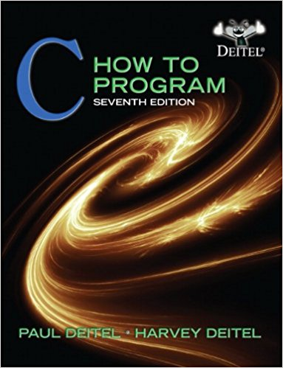
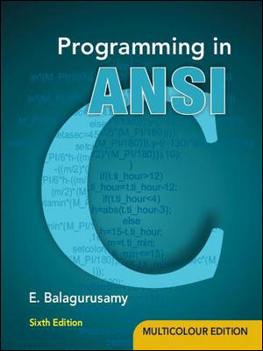
Reference Books
“C HOW TO PROGRAM” by
PAUL DEITEL AND
HARVEY DEITEL
PHI(Prentice Hall India)
“PROGRAMMING IN ANSI C”
By E. BALAGURUSAMY
McGraw Hill Education

Slide 4
Syllabus and Instruction Plan(IP)

Slide 5
Course Assessment Model
Marks break up
Attendance 5
Academic Task 25
MTE 20
ETE 50
Total 100

Slide 6
Academic Task
Component Week
Online Assignment 3 5th
Online Assignment 2 9th
Online Assignment 3 11th
Total Weeks: 14( 7 Before MTE and 7 After MTE)

Slide 7
Mode of Conduct
BYOD(Bring your own device)
Note: Laptops are mandatory for program implementation.

Slide 8
Daily routine
Let us look around our daily routine…
Let us see where all we do programming everyday
Simple things we do to start the day
This too has a set procedure. One follows particular steps to accomplish the task.
So there is ONE program you know which is there in you…

Slide 9
Daily routine
There is a set procedure
Each step is defined
The occurrence is ordered
Jump is NOT permitted
A step cannot be skipped
Start
Pick Brush
Rinse Brush
Apply Paste
Brush
Rinse Mouth
Rinse Brush
Stop

Slide 10
Daily routine
Let us explore more as the day goes by…
Going for a morning 0900 AM Class
Going for a movie at 0900 AM
It is all about WHICH program is loaded WHEN

Slide 11
Daily routine
The flow changes
Start
Go!!!
Where
To
Go?
Class
Movie
Stop
Stop

Slide 12
So what does this mean?
Take ANY activity of the day…
It will have a set procedure
It has to be done in a designate way
If not done the specified way will yield wrong results
Success in doing it depends on how closer one is to the prescribed method
This clearly shows that everything has a
Logic

Slide 13
What next?
If there is logic in anything and everything
There has to be ways to represent logic
There has to be modes to modify and re-represent logic
There should be methodology to implement and re-design logic
And for all this…

Slide 14
What next?
There has to be logic machine to assimilate, understand, solve, store, retrieve and represent logic
There has to be a LANGUAGE to communicate with the logic machine
Otherwise….

Slide 15
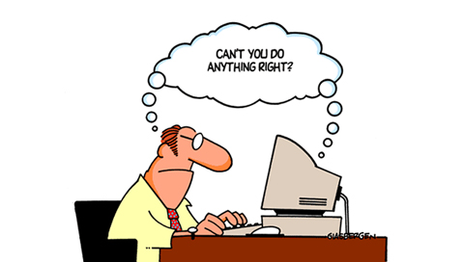
Diving deeper…

Slide 16
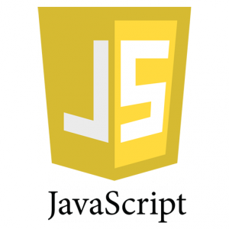
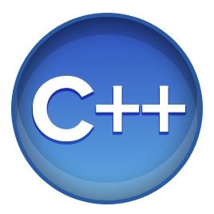
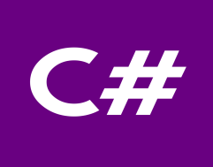
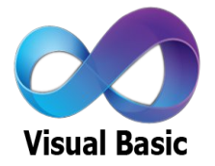
WHY C???????????????
If we have number of powerful programming languages available with us then why c??????

Slide 17
The hitch...............
Some burning questions in mind......
C is a very old language. Why are we still studying this language??????
Now, we have very powerful languages with us then, why c??
There is no scope of this language in industry

Slide 18
Lets take you close to the reality
All of us use Computers or Laptops for different purposes.
Could you tell me which system software is most required to get our system in working mode??????

Slide 19
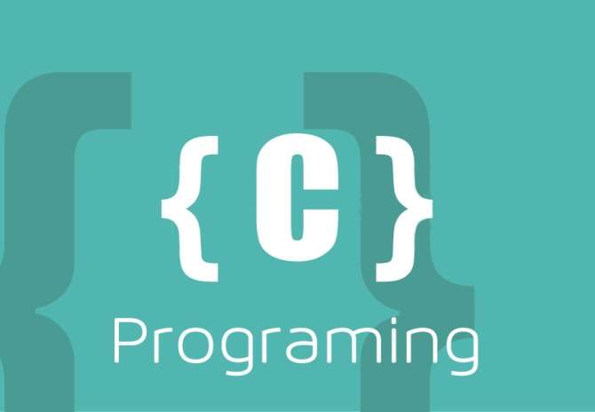
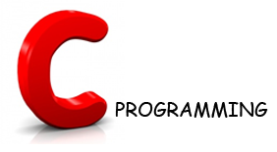
Let’s Explore more
Could you tell me which programming language is used in writing all these operating system??????
Latest version of Microsoft Windows i.e. Windows10 is still being written in C Language

Slide 20
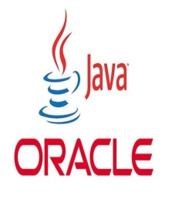
Contd.....
Device drivers are also written in C language.
All these modern programming languages are influenced by C language
Compilers for Python and PHP language are also written in C language

Slide 21
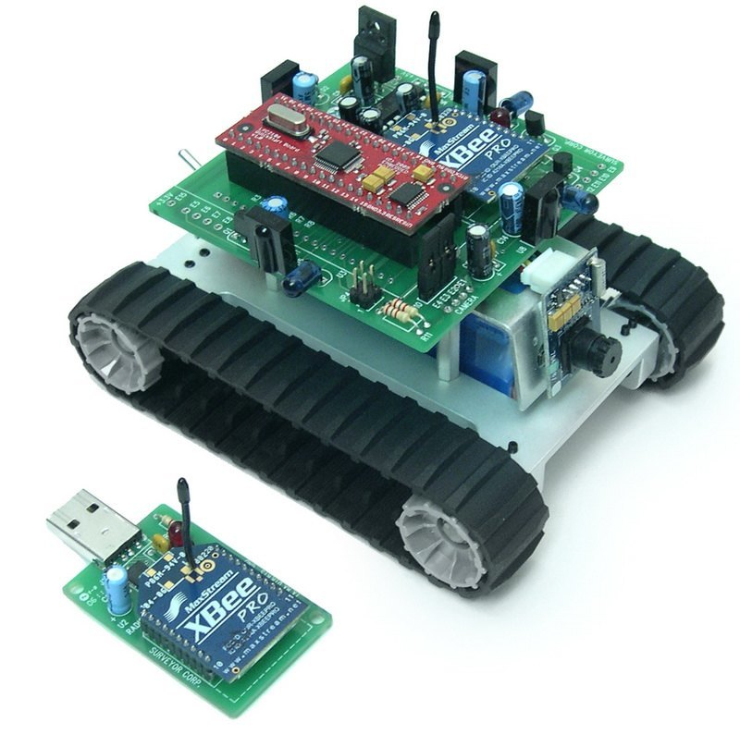
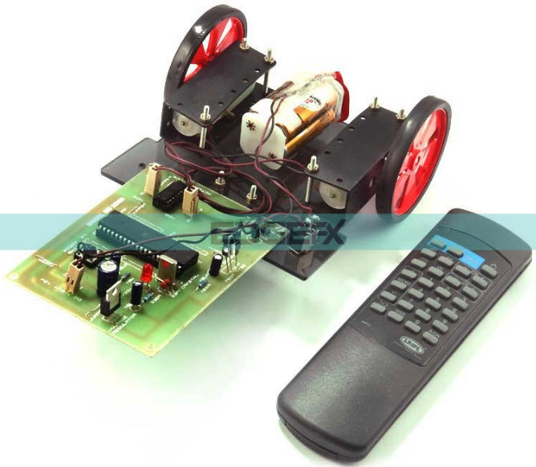
Contd.....
Embedded systems are also developed with the help of C language

Slide 22
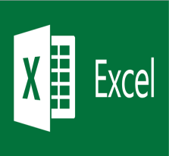
Contd.....
Git
 | Microsoft Excel
Oracle Database
 | MySql
Linux
 | Unix
Android
 | Google

Slide 23
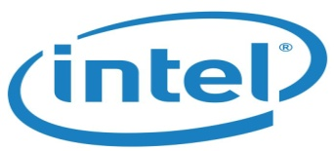
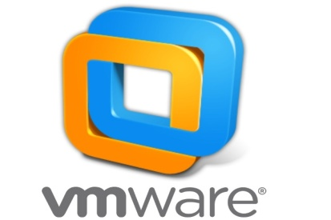
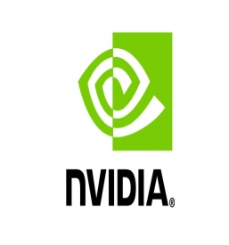
MNCs
Top rated Companies which has a dearth of C programmers

Slide 24
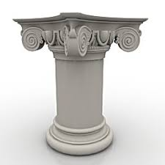
Here are the Answers of Questions
C is very a old language still, why do we study C language??
Now, we have very powerful languages
with us then why c??
There is no scope of this language in industry
Basic Pillar
https://www.youtube.com/watch?v=CYvJPra7Ebk

Slide 25
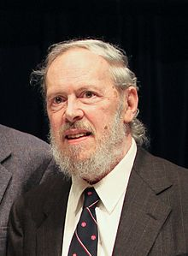
History of C
Dennis Ritchie and Ken Thompson were working on developing a new operating system i.e UNIX
But the programming language they
were using was not providing them
the portability feature
So Dennis Ritchie developed new
language i.e C

Slide 26
History continued...

Slide 27
Why “C” name was given???
Many of C’s principles and ideas were derived from the earlier language B. (Ken Thompson was the developer of B Language.)
BCPL and CPL are the earlier ancestors of B Language
CPL is Combined Programming Language. In 1967, BCPL Language ( Basic CPL ) was created as a scaled down version of CPL
As many of the features were derived from “B” Language thats why it was named as “C”.
After 7-8 years C++ came into existence which was first example of object oriented programming .

Slide 28
Evolution of C...

Slide 29
Language Developers

Slide 30
Features of C Language
Low Level Language Support
Program Portability
Powerful and Feature rich
High Level Features
Modular Programming

Slide 31
It can be defined in following ways:
It can be defined by the following ways:
Mother language
System programming language
Procedure-oriented programming language
Structured programming language
Mid-level programming language

Slide 32
Course Contents
Before MTE
Data Types & Operators Control Structures
User Defined Functions Storage Classes
After MTE
Arrays and Strings Pointers
Dynamic Memory Allocation Derived Data Types- Structures and Union

Slide 33
Tools
Offline Compiler Code Blocks:
http://www.codeblocks.org/downloads
Online compiler CPP shell:
http://cpp.sh/

Slide 40
MCQ
Q1 Who is the father of C language?
Bjarne Stroustrup
James A. Gosling
Dennis Ritchie
Dr. E.F Codd

Slide 41
MCQ
Q2 C was primarily developed as?
System Programming Language
General Purpose Language
Data Processing Language
None of the above

Slide 42
Basics and introduction to C
Program Development in C

